Slide 1
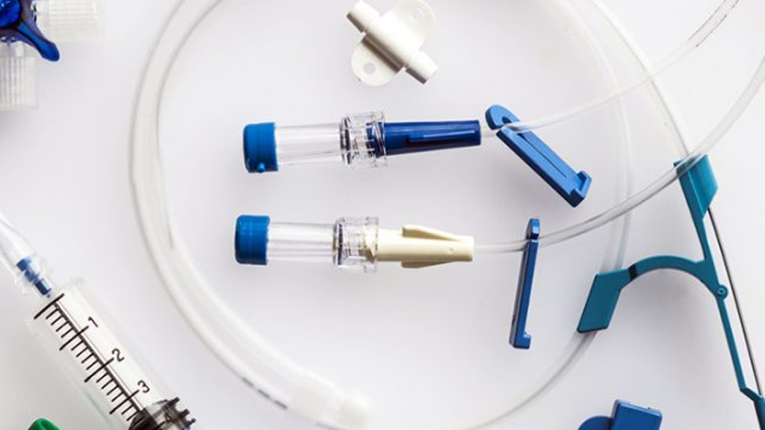
Central Venous Catheter Insertion
Imri Amiel
Director, General Surgery Residency Program
Sheba Medical Center, Ramat-Gan, ISRAEL

Slide 2
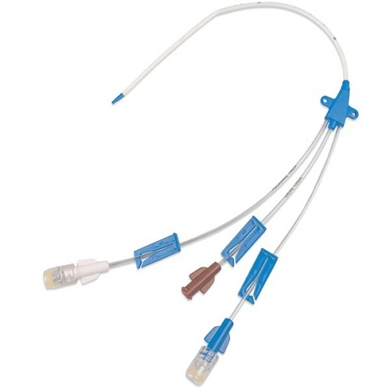
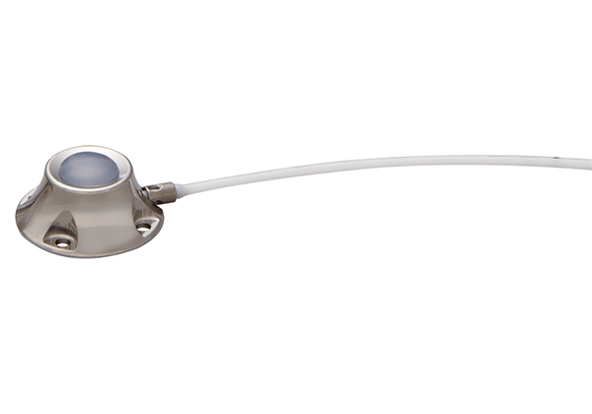
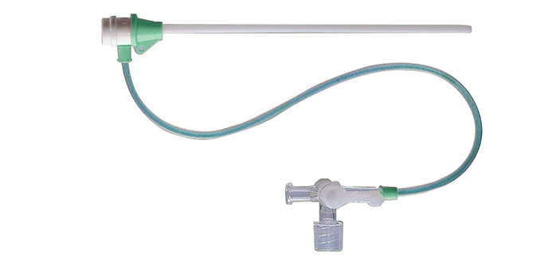
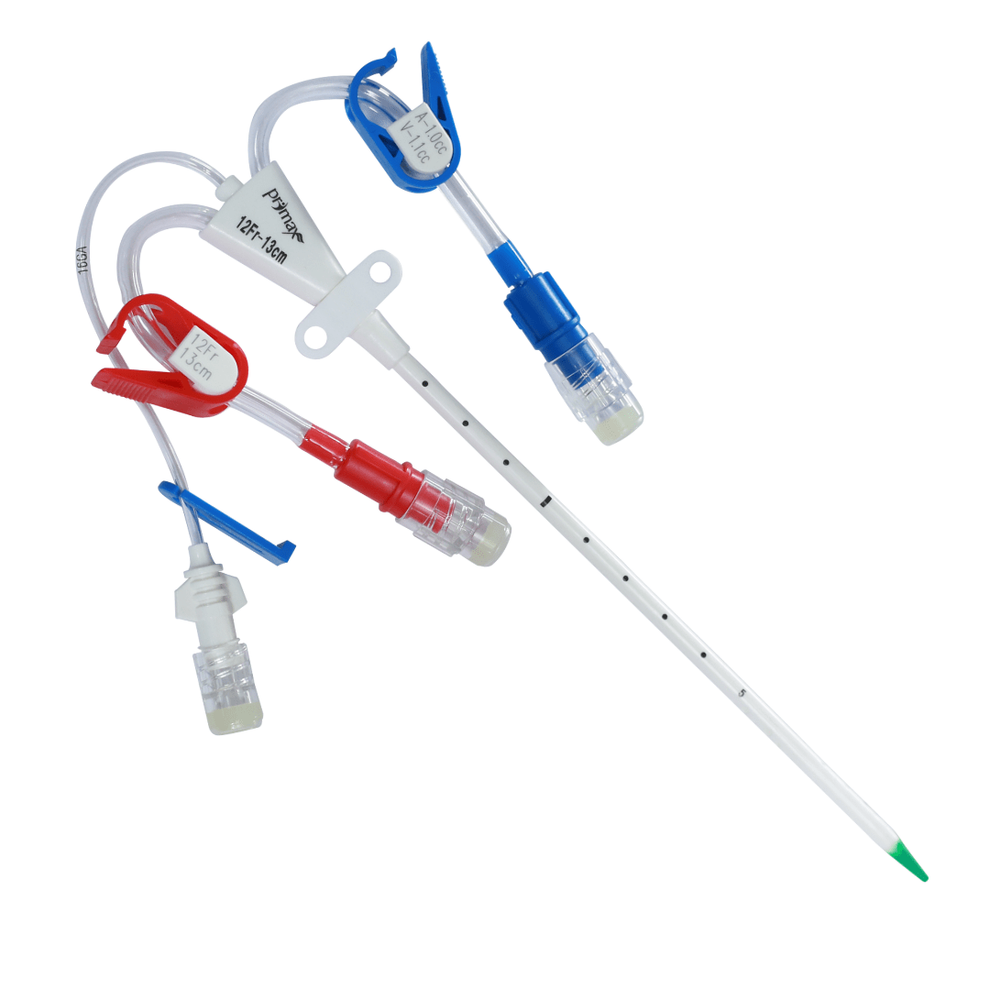
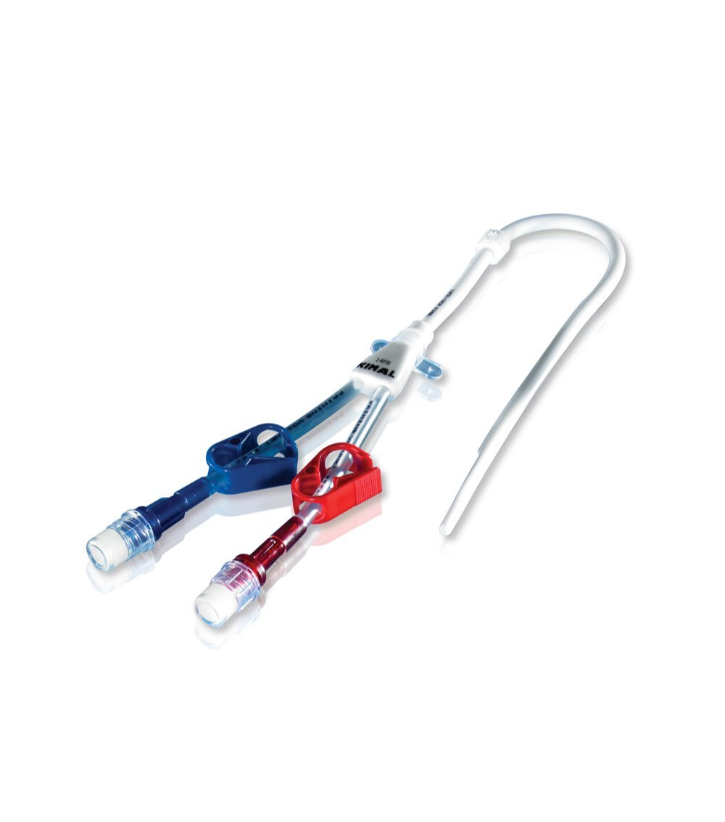
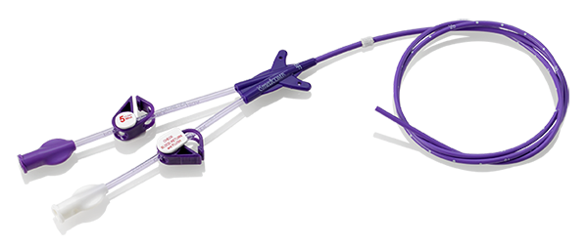
Different Central Lines
CVC – Central Venous Catheter
High-flow
Dialysis line
Perma-cath
Port-a-cath
Hickman
Picc-line
Midline

Slide 3
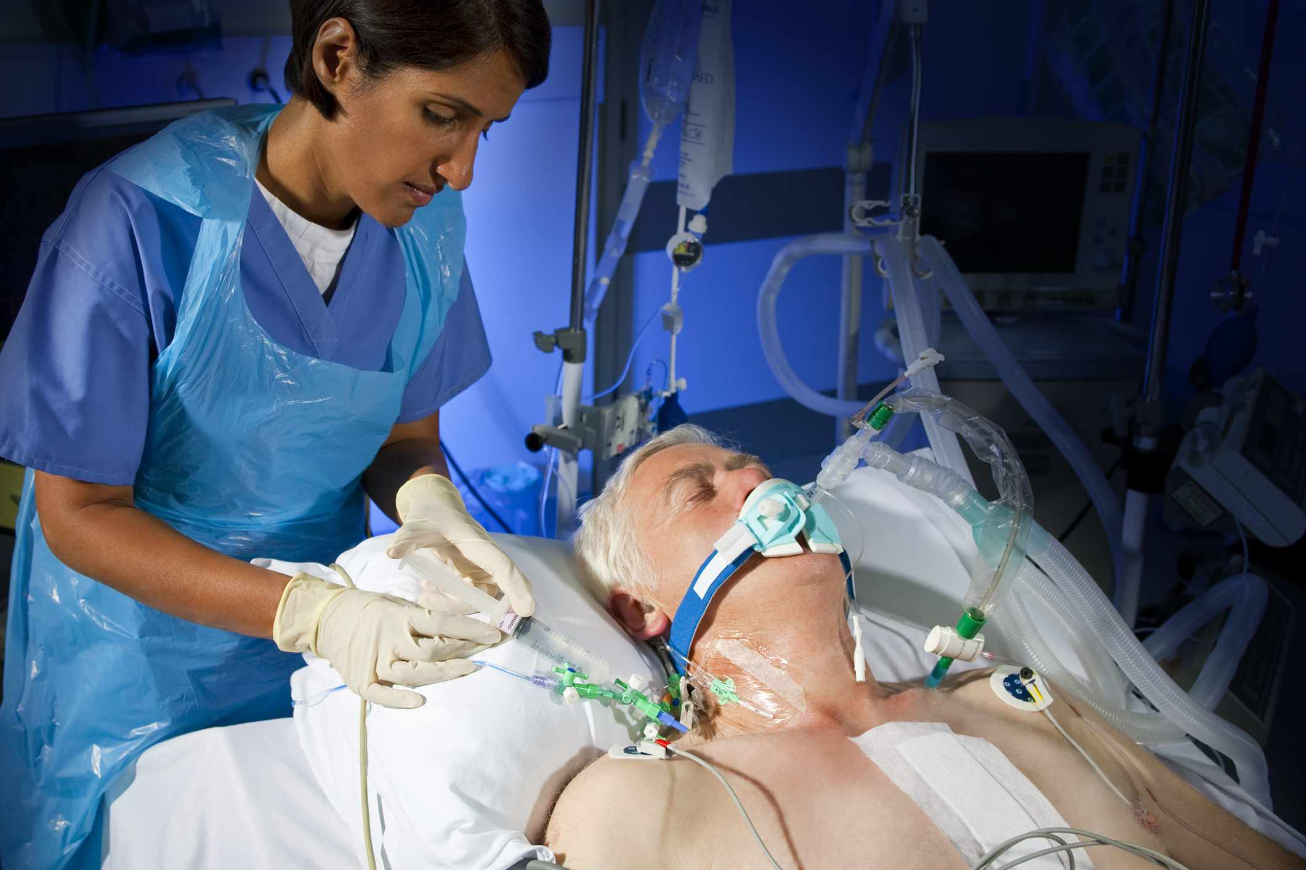
Central Line Advantages
Different drugs in different lumens at the same time
Central venous pressure measurement
Taking blood samples

Slide 4
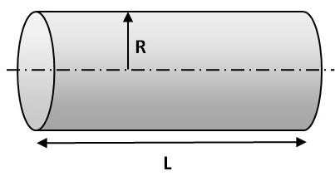
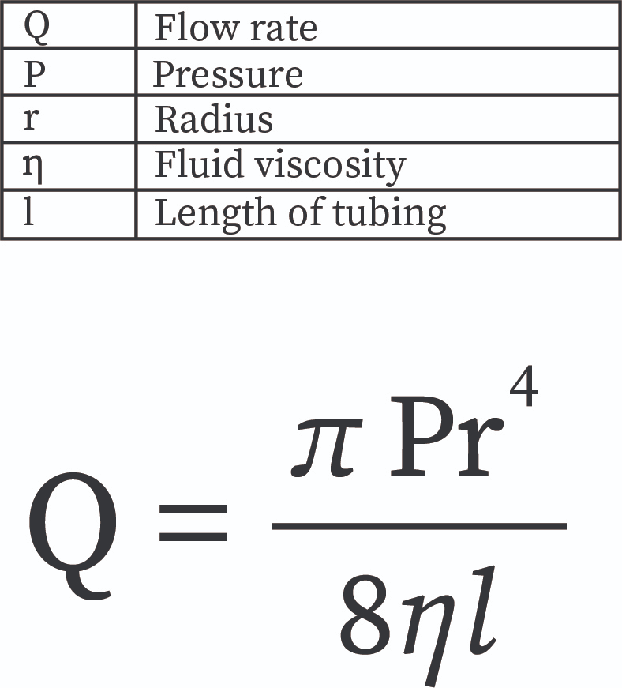
Central Line Disadvantages
Low flow rate according to “Poiseuille low”
Risk for complications during insertion
Demands expertise and experience
Risk for Venous Thromboembolic events
Risk for infection

Slide 5
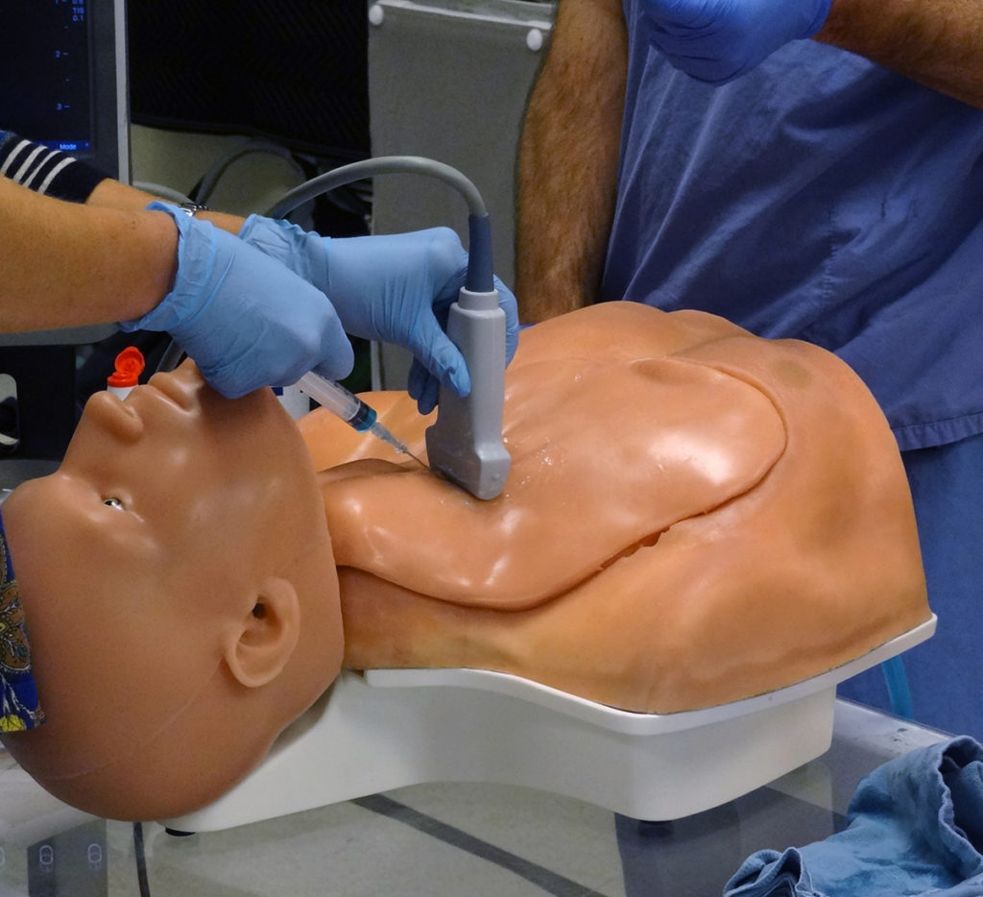
Indications
Lack of peripheral venous access
Medications given only with central access (Vasopressors, concentrated electrolytes, TPN etc.)
CVP – advanced hemodynamic monitoring
Hemodialysis
Others: Plasmapheresis, Stem-Cell transplant etc.

Slide 6
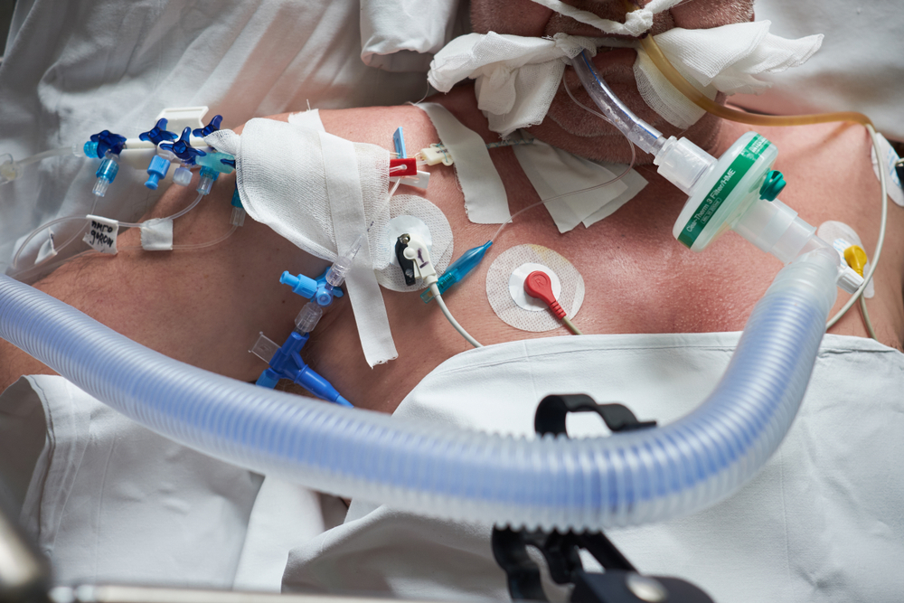
Complications
Damage to arteries
Bleeding
Pneumothorax
Chylothorax
Incorrect placement
Arrythmias

Slide 7
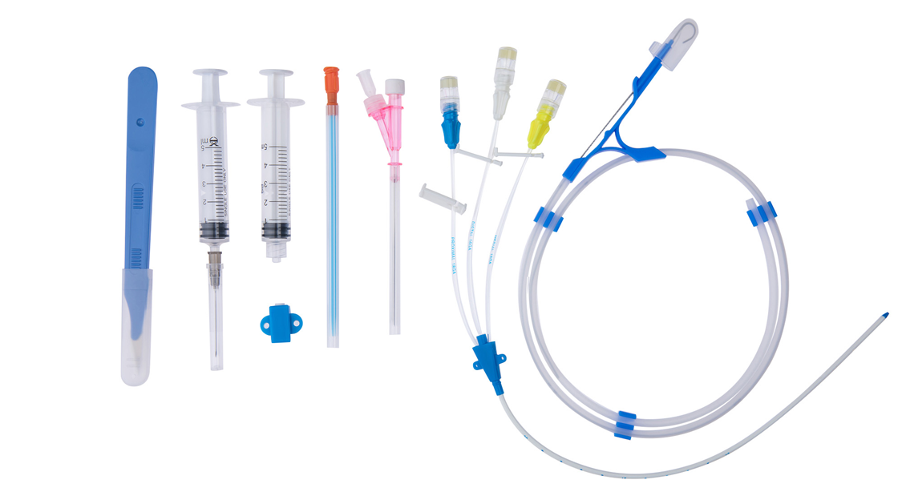
Preparations
Choice of insertion site
Choice of catheter type and size
Patient preparation
Equipment preparation

Slide 8
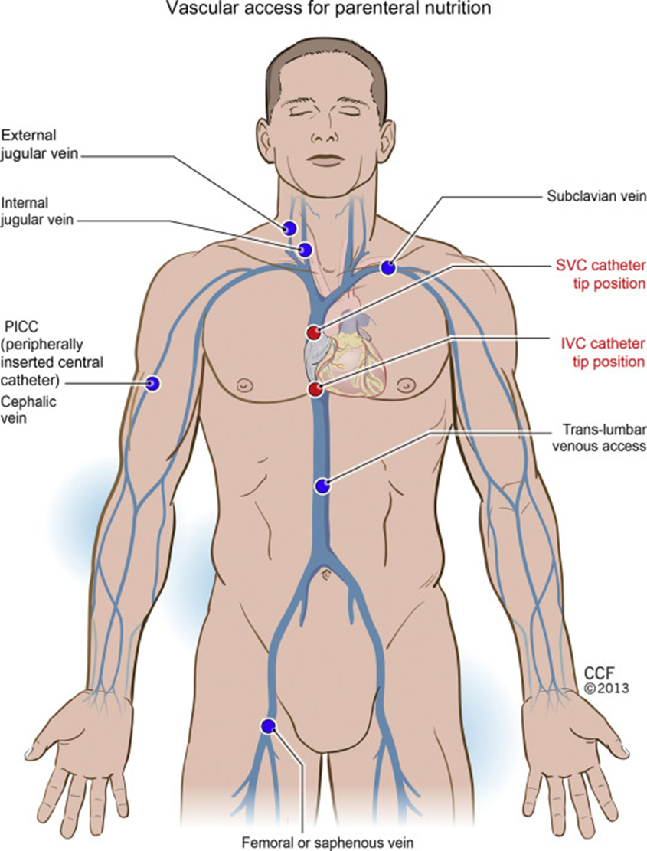
Insertion Sites
Internal Jugular vein
Subclavian vein
Femoral vein

Slide 9
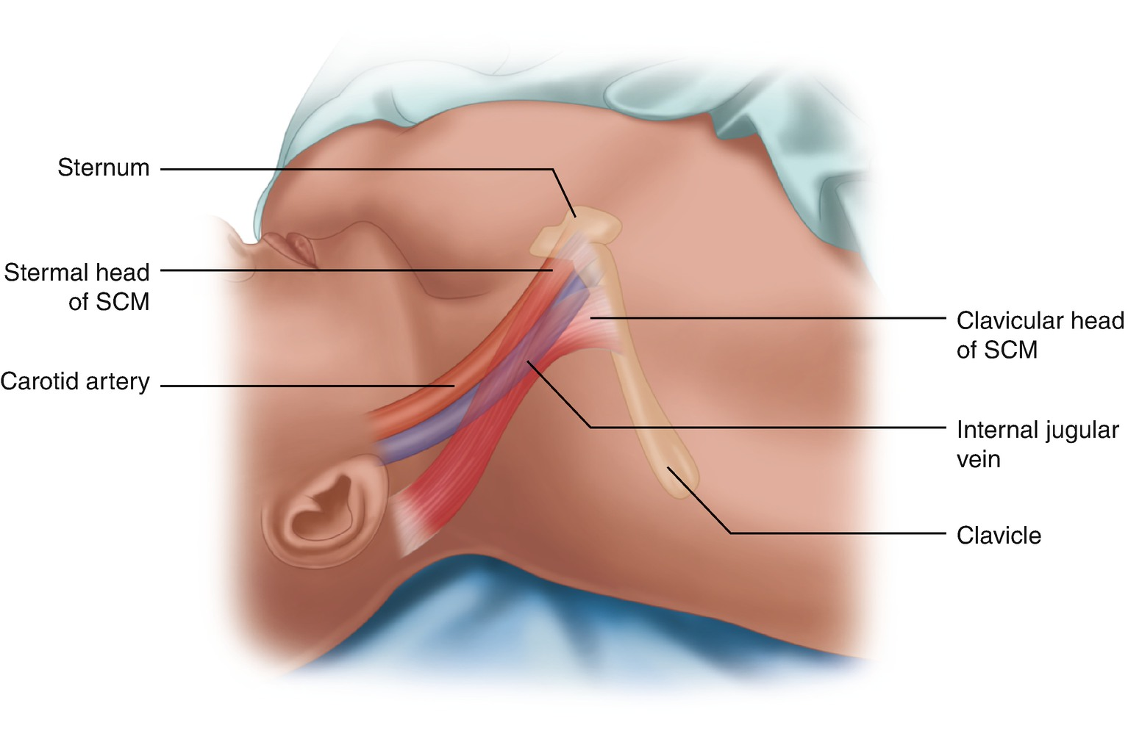
Internal Jugular Vein
Advantages:
Relatively clean (except in the presence of tracheostomy)
Allows for CVP measure
Disadvantages:
Uncomfortable for awake patients
Demands CXR after placement
Necessitates US assistances

Slide 10
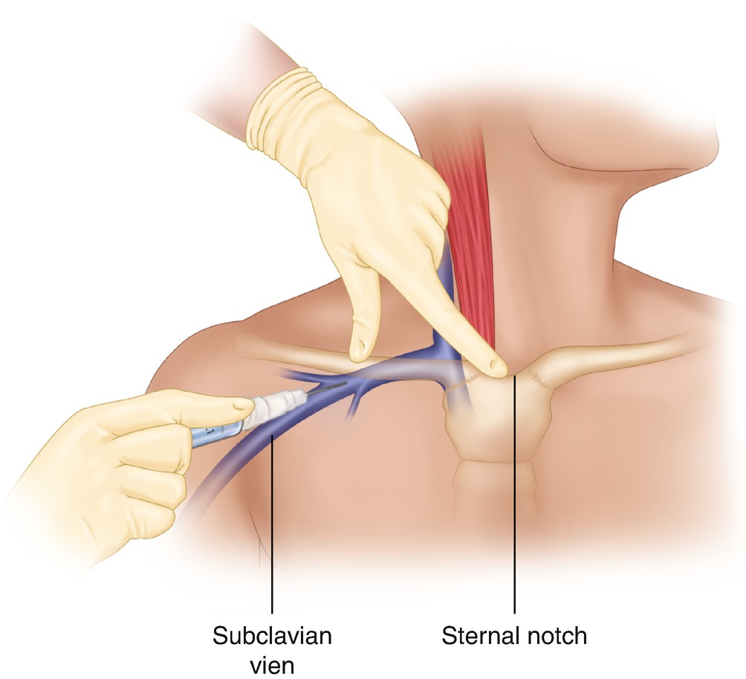
Subclavian Vein
Advantages:
Most comfortable for patients
Cleanest site
Allows for CVP measure
Disadvantages:
Most complications during insertion
Demands CXR after placement

Slide 11
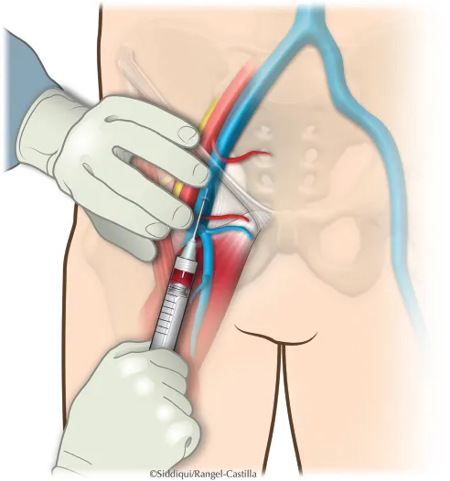
Femoral Vein
Advantages:
Safe and easy to insert
Doesn’t demand a CXR after placement
Doesn’t necessitate a US assistance
Disadvantages:
Dirtiest site
Highest rate of VTE’s

Slide 12
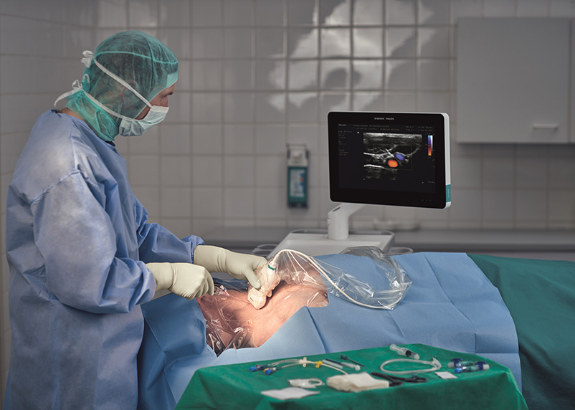
Preparing the Patient and Scene
Informed consent
Propper positioning
Trendelenburg
Equipment on Mayo table
Ultrasound
Checklist

Slide 13
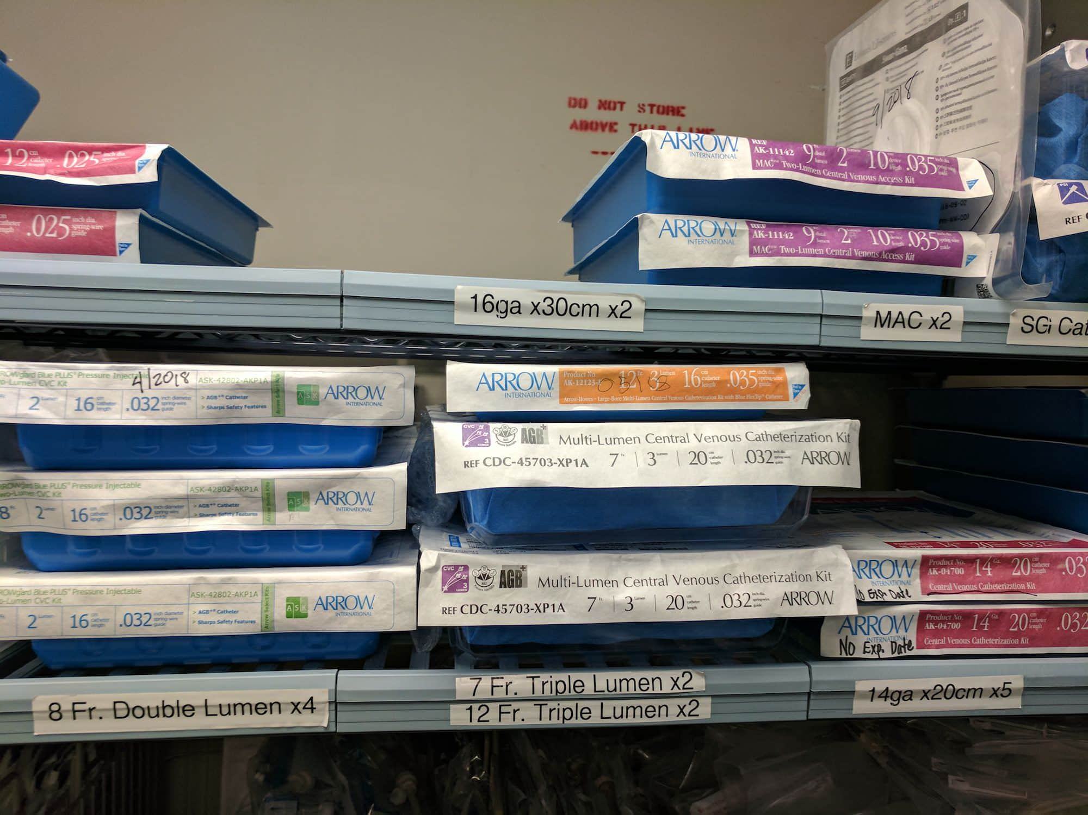
Choice of the proper catheter type and size
Width
14-18G or 7-8FG
Number of Lumens
Usually 3-4
Length
15-30cm (depends on location)

Slide 14
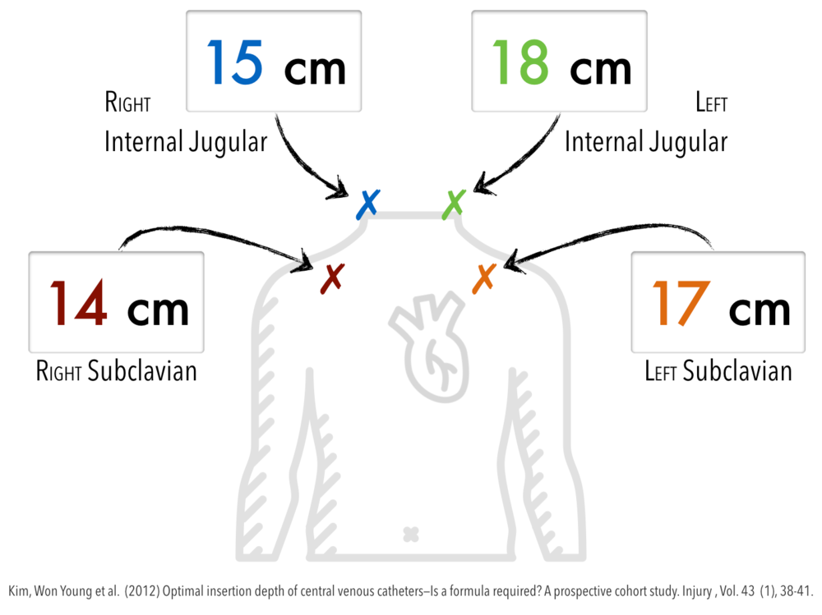
Length of Catheter

Slide 15
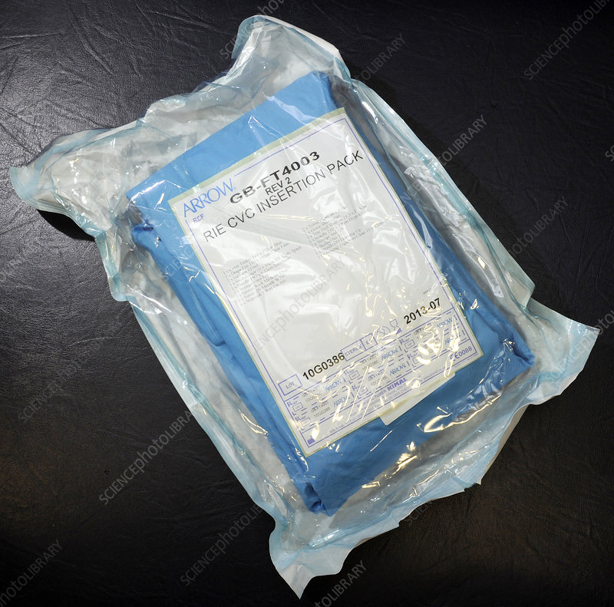
CVC Insertion Kit
Face mask + cap
Sterile field
Sterile gown
Sterile total body drape + extension
Bowl with cotton balls (for disinfection)
Empty bowl (for saline)
Syringes + Needles
Needle holder + Scalpel
Magnet \ Sharp container
Gauze pads (X10)

Slide 16
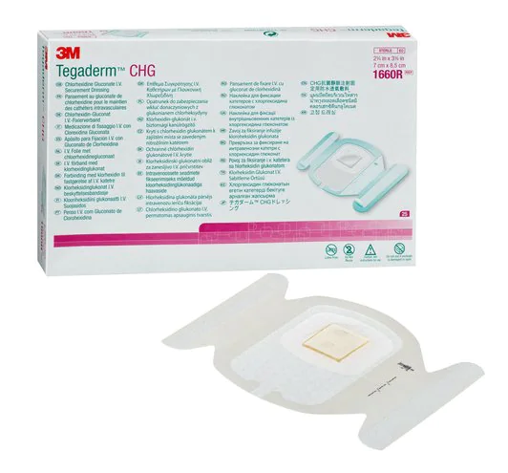
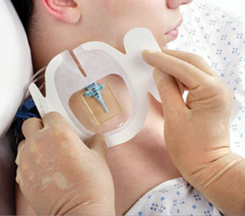
Additions to Insertion Kit
Catheter set (see proper type and size)
Sterile gloves in the proper size
Antiseptic solution (or stick e.g. ChloraPrep)
Local anesthetics (Lidocaine 1%)
Suture for fixating (0 silk)
Needleless connector (as the number of lumens)
Saline (3-4 ampules of 10cc)
Dressing (antibacterial film e.g Tegaderm CHG)
Sterile cover for US probe
Sterile Gel (for US)

Slide 17
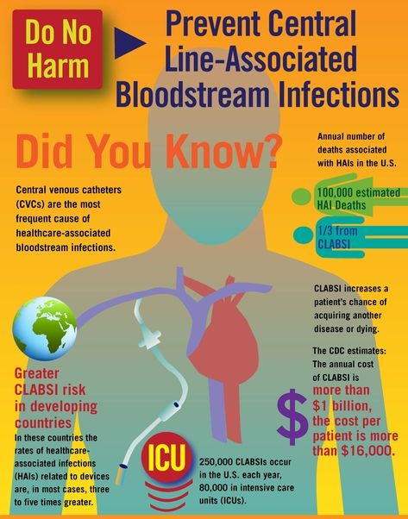
Central Line-Associated Blood Stream Infection (CLABSI)
Up to 25% mortality!
Estimated cost per case= = 46,000$!
Decrease rate after usage of CLABSI Bundle
Decrease d\t US assistance
Decrease d\t Insertion Kit with total body cover
Decrease d\t Checklist implementation
Decrease d\t appropriate antiseptic technique
Reduce the time of use or change to a tunneled catheter
Notes:
Based on the National Healthcare Safety Network (NHSN) data from January 2006 to October 2007, the order of selected pathogens associated with causing CLABSI are as follows. Gram-positive organisms (coagulase-negative staphylococci, 34.1%; enterococci, 16%; and Staphylococcus aureus, 9.9%) are the most common, followed by gram negatives (Klebsiella, 5.8%; Enterobacter, 3.9%; Pseudomonas, 3.1%; E.coli, 2.7%; Acinetobacter, 2.2%), Candida species (11.8%), and others (10.5%).
The femoral central venous catheters are associated with the highest risk of CLABSI followed by the internal jugular, and subclavian catheters. Further, the catheter type, conditions of insertion (emergent versus elective, use of full barrier precautions versus limited), catheter care, and skill of the operator also influence the risk of CLABSI.

Slide 18
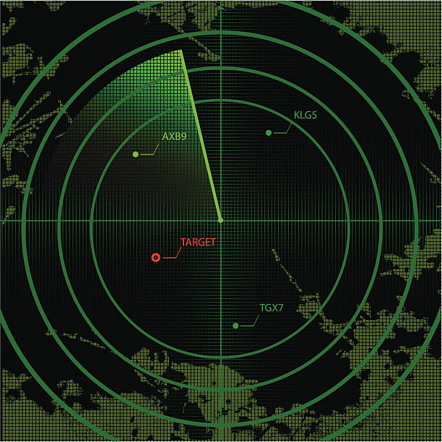
Ultrasound Directed Insertion
Decreases complications
Decreases infection rates
Medical standard of care

Slide 19
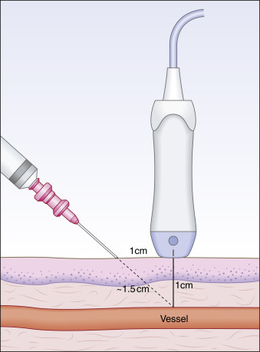
Ultrasound Advantages
Anatomic view prior to insertion
Real time guidance of needle puncture
Placement verification

Slide 20
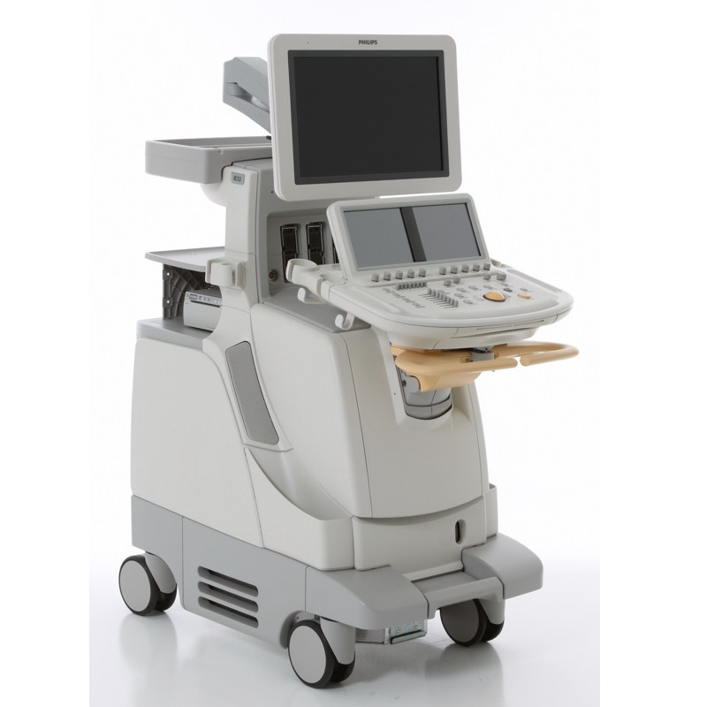
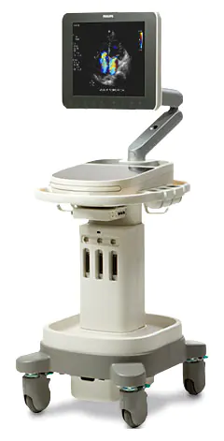
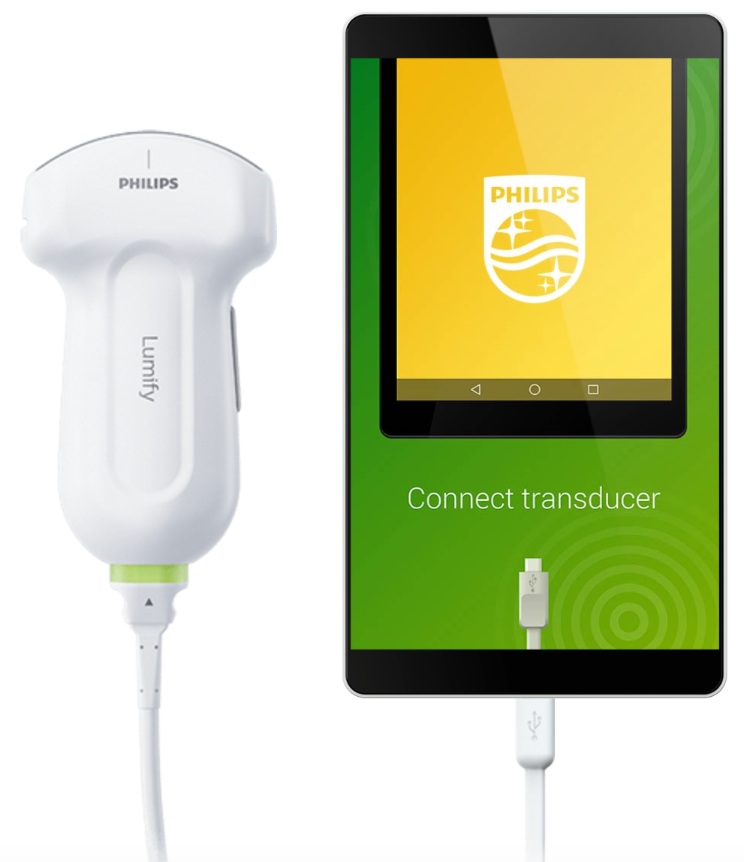
Ultrasound Devices
Standard machine
Mobile machine
Ultra compact device

Slide 21
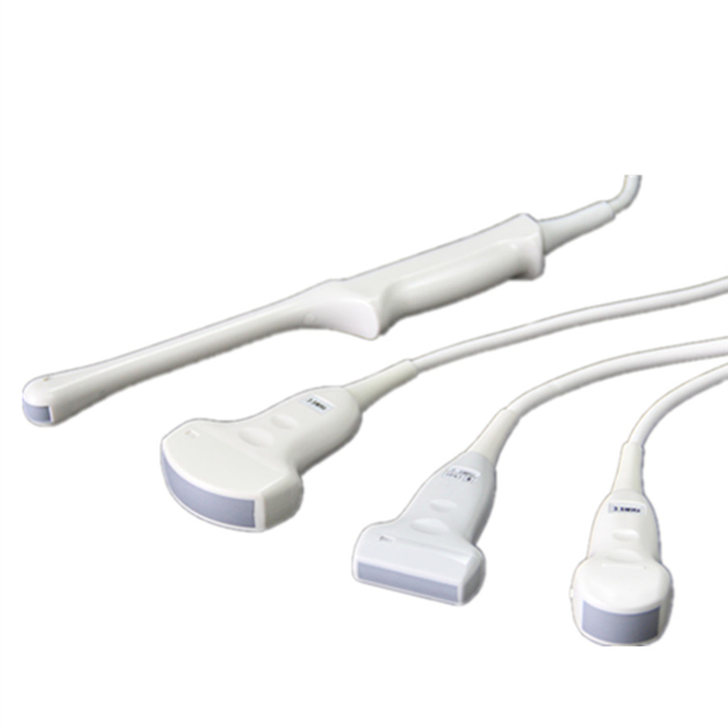
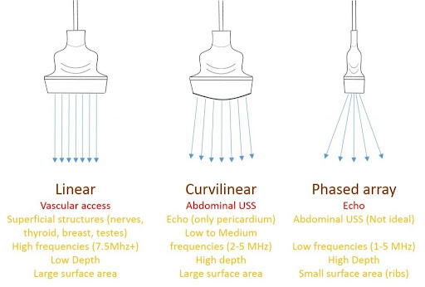
Transducers

Slide 22
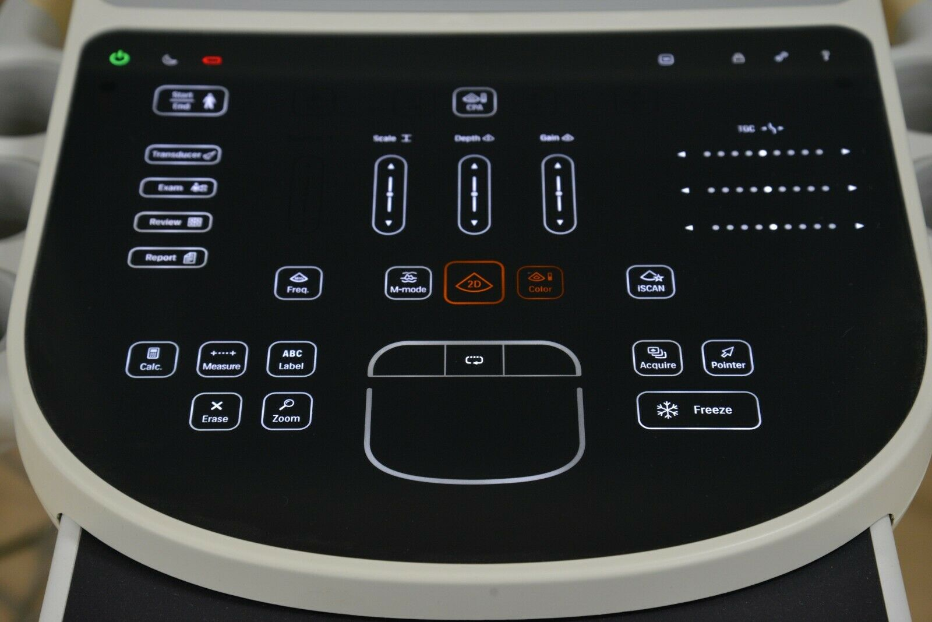
Knobology
On \ Off
TRANSDUCER
DEPTH
GAIN
COLOR (Doppler)
FOCUS
M-MODE (Middle line)
FREEZE

Slide 23
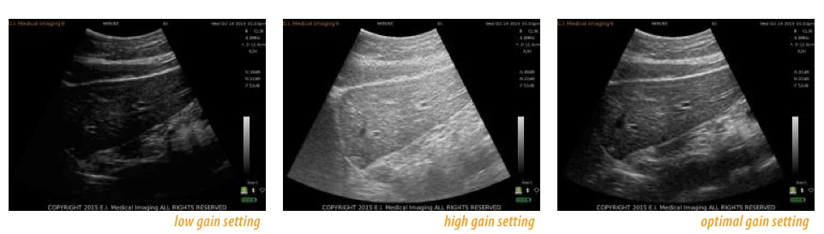
Gain

Slide 24
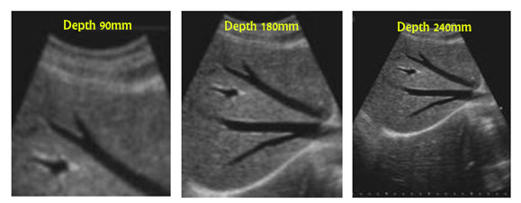
Depth

Slide 25
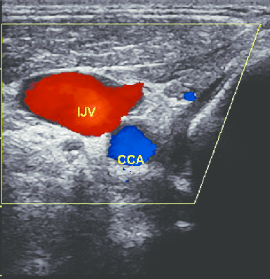
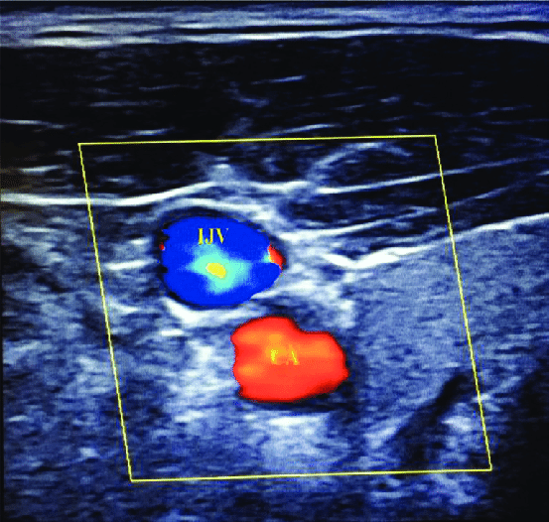
Doppler
BART - Blue Away, Red Toward
Notes:
Blood vessels have a distinct appearance on color Doppler mode: flow toward the probe appears red, while flow away from the probe appears blue. A useful mnemonic used by radiologists is BART, i.e., Blue Away, Red Toward. When the angle of incidence is close to 90° and flow is low, there may be no color on the screen, possibly producing a false negative indication of “no flow”

Slide 26
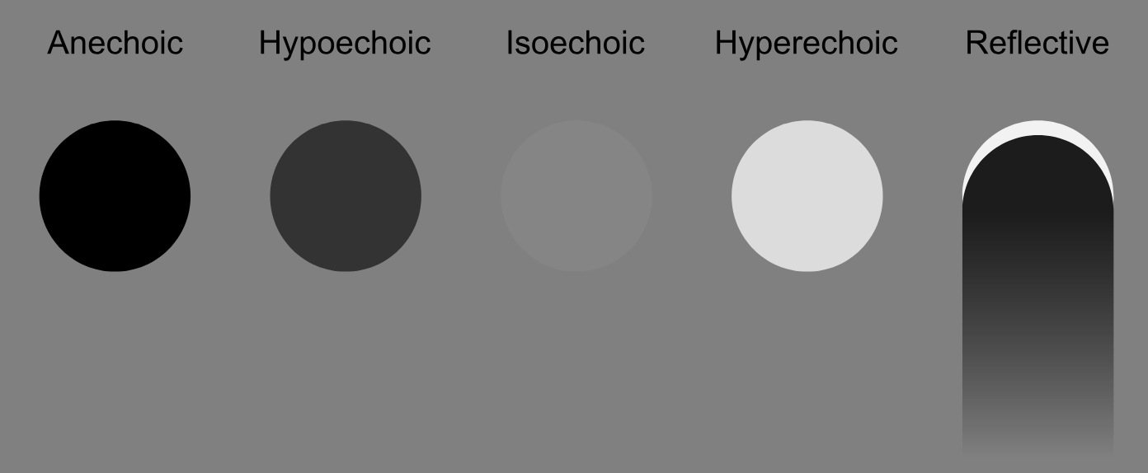
Echogenicity
Hyperechoic = White (Nerves, Fascia)
Hypoechoic = Grey (Viscera)
Anechoic = Black (Bone, Vessels, Liquid, Fat) - Bone is impenetrable for sound waves and thus reflects a ”shadow” underneath

Slide 27
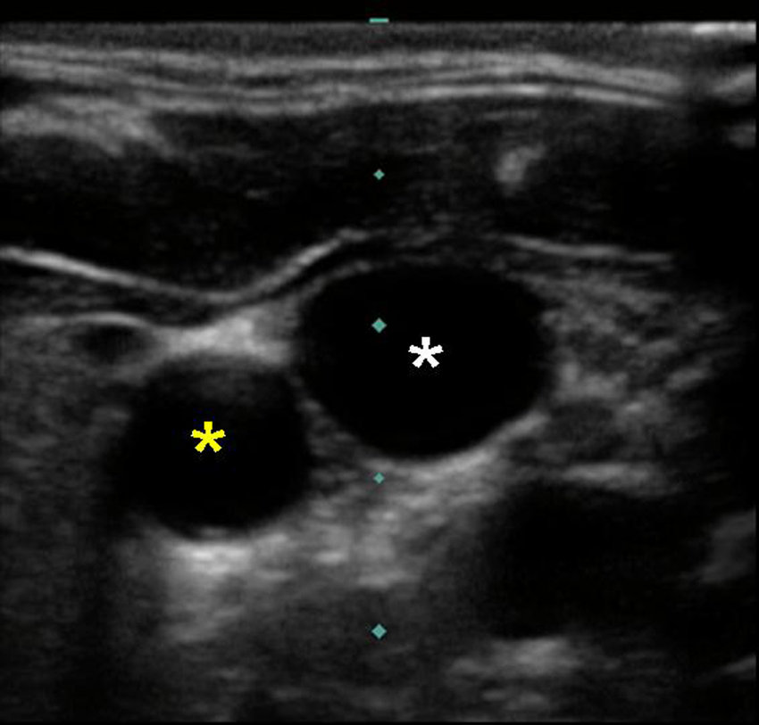
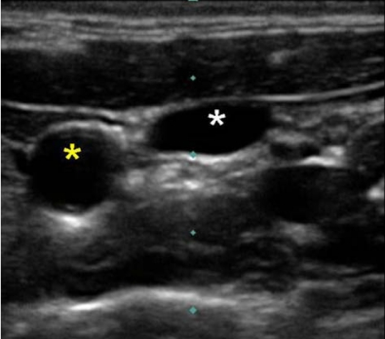
Right IJ View – What is the difference?

Slide 28
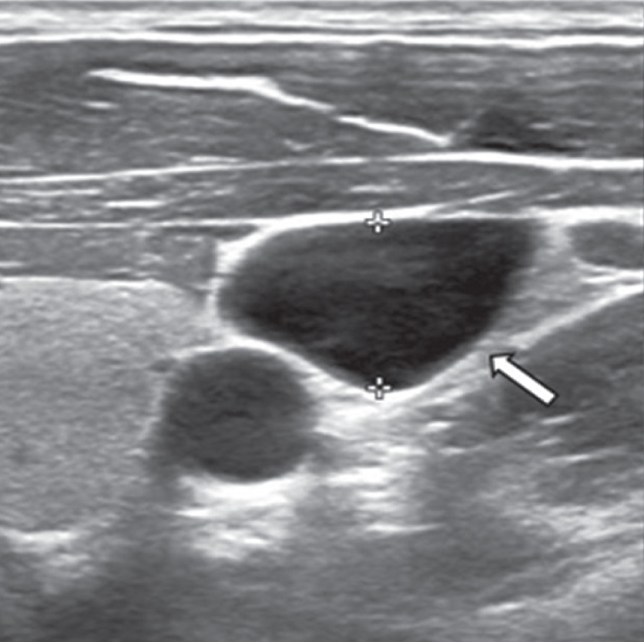
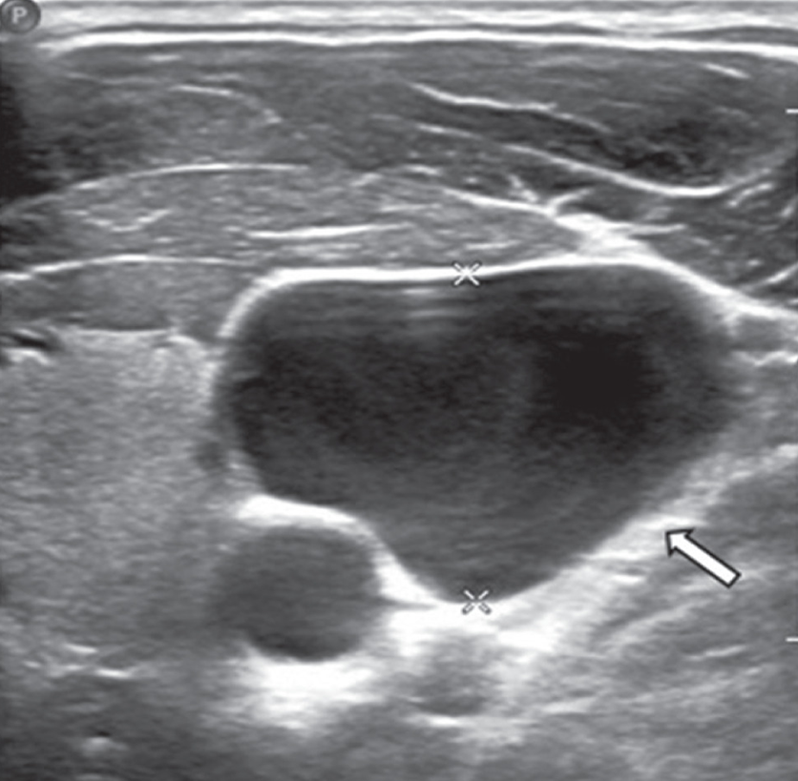
Right IJ View – What is the difference?

Slide 29
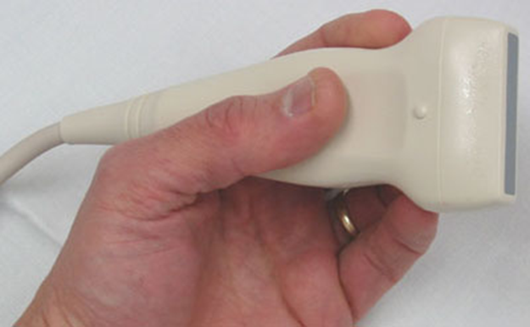
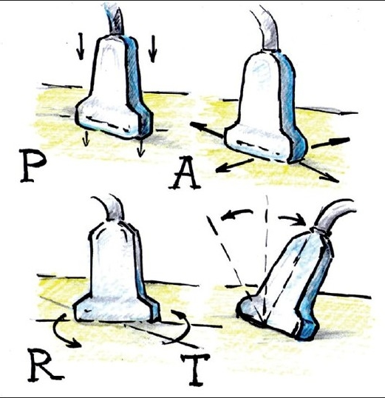
Ultrasound Usage
Propper Handling of the probe
Propper Orientation of the probe
Dynamic Usage of the probe
PART (Pressure, Alignment, Rotation and Tilt)

Slide 30
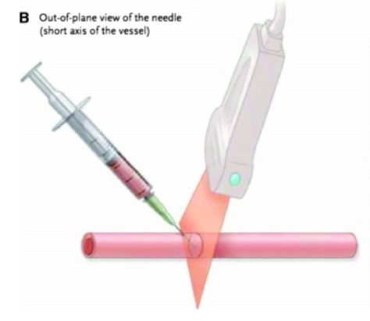
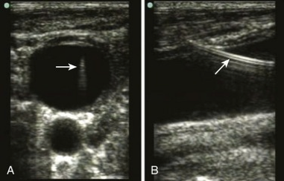
Transverse Vs Longitudinal view

Slide 31
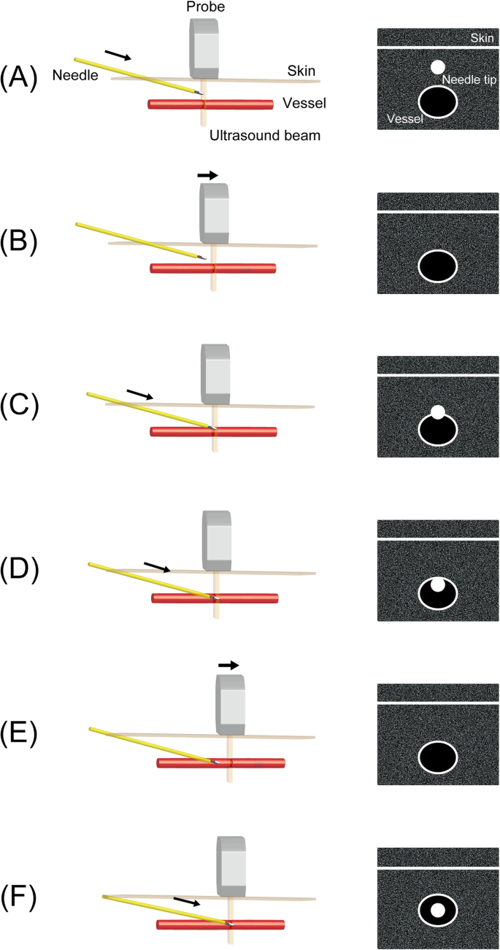
Transverse view

Slide 32
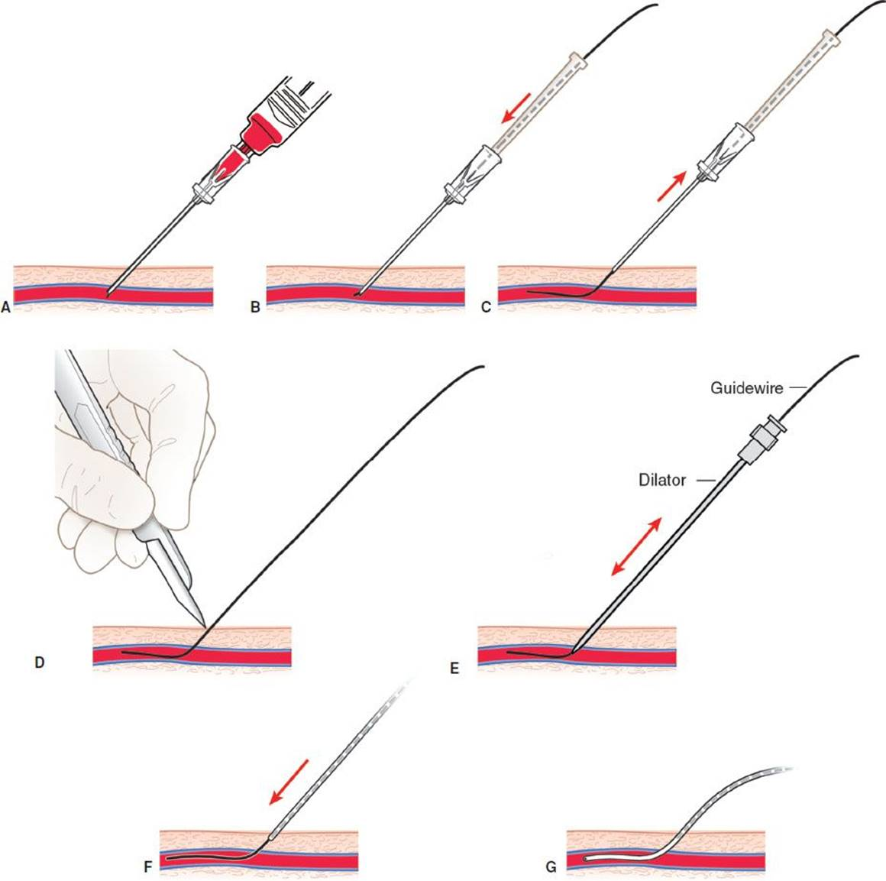
Steps
Skin disinfection
Total body coverage with sterile drapes
Arranging the equipment on a Mayo stand
Covering the probe with sterile cover
Puncture of the vein with real time US (A)
Leading the guide through the needle (B)
Needle withdrawal (C)
Skin cut with 11 blade scalpel (D)

Slide 33
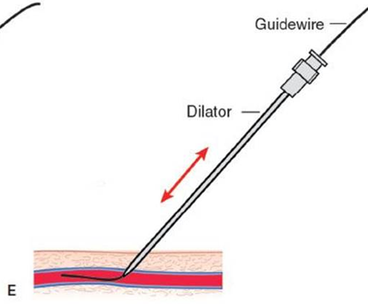
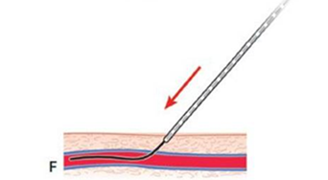

Steps (cont.)
Insertion the dilator over the guide (E)
Withdrawal of the dilator
Insertion the catheter over the guide (F)
Withdrawal of the guide (G)
Taking blood for culture (20cc syringe)
Flushing the lumen with saline
Suturing the catheter in 3 points
Cleaning and drying the insertion site
Dressing

Slide 34
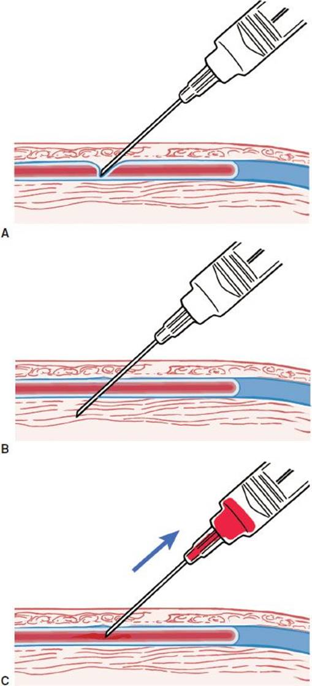
Problem Solving
Through and through puncture of the vein
Resistance during guide insertion
Catheter not advancing
Lack of blood drawing (via catheter, once placed correctly)

